Slide 1
Topic Modeling
on
Amazon Fashion Reviews
Team : Ailin Sun, Ankitha Shetty, Jhaanvi Golani, Sandra Joseph

Slide 2





Agenda
Problem Statement
Objective
Data Preprocessing
Model formulation
& development
Impact

Slide 3

Problem Statement
With the rapid accumulation of online reviews Sellers and Companies need methods to
Analyze reviews and make improvements to their products
Identify most common topics in reviews to gain more insights

Slide 4

Objective
Identify the categories of highly rated reviews by analyzing online reviews
Identify topics for a most positively reviewed product
Identify the most discussed topics for negative reviews
Identify topics for a most negatively reviewed product

Slide 5

What is Topic Modeling?
The process to automatically identify topics present in a text object and to derive hidden patterns exhibited by a text corpus. Thus, assisting better decision making
Team will use LDA and BERT, to find the topics from the Amazon Reviews

Slide 6

About the dataset
Data source: http://jmcauley.ucsd.edu/data/amazon/links.html
Details:Rows count- 883636, Column count-12
Category: Amazon fashion
Useful column: Review,overall(Rating)

Slide 7

Data Preprocessing
Drop Nan values
Remove punctuations
Remove numbers
Remove stopwords
Lemmatization of data
Notes:
Stopwords from NLTK and spacy’s en model for text pre-processing. Later, we will be using the spacy model for lemmatization.

Slide 8

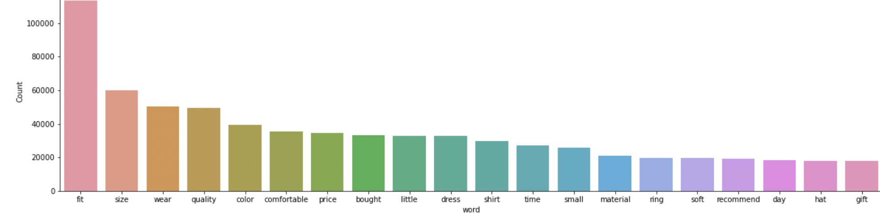
Word frequency analytics

Slide 9
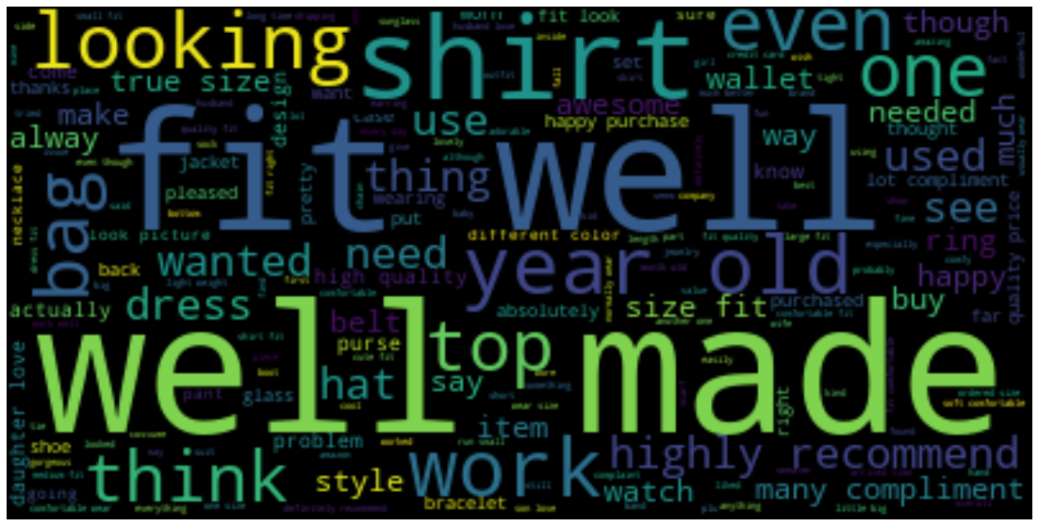
Positive Reviews

Slide 10
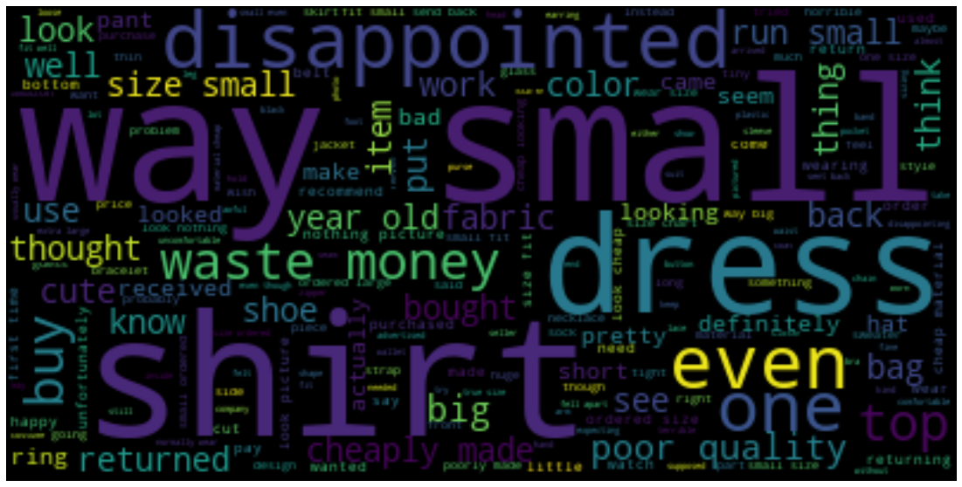
Negative Reviews

Slide 11

What is LDA?
Latent Dirichlet Allocation is a a topic modelling technique which uses Dirichlet distribution to find topics for each document model and words for each topic model.
Two important notes:
The users must decide on amount of topics present in the document
The user must interpret what the topics are
Notes:
LDA is a technique to map sentences/document to topics. LDA extracts certain sets of topic according to topic we fed to it.
LDA assumes that:
· Documents with similar topics use similar groups of words, by searching for groups of words that frequently occur together in documents across the corpus, Latent topics can be found
· Documents are probability distributions over latent topics which signifies certain document will contain more words of a specific topic.

Slide 12

LDA- Steps in creating model
To use a topic modeling technique, you need to provide
(1) a document-term matrix and
(2) the number of topics you would like the algorithm to pick up.
Once the modeling(gensim version) technique is applied, interpret the results and see if the mix of words in each topic make sense. Visualize using PyLDAvis.

Slide 13
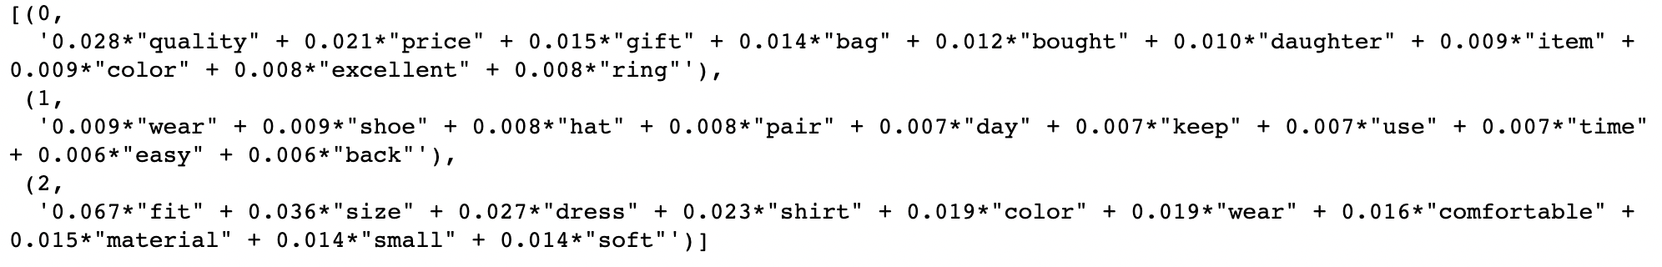

LDA - Topics highly rated reviews
Identify the categories of highly rated reviews by analyzing online reviews
Categories from LDA:
Jewellery
Shoes
Clothes

Slide 14
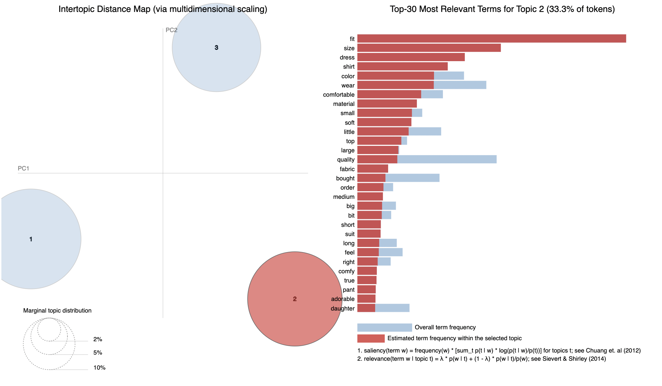
Visualize using PyLDAvis
Notes:
Red bar, frequency of give word for a topic, I have chose topic 2 and you can see the frequency of words compared to the overall frequency of words

Slide 15

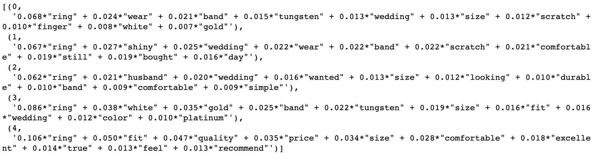
LDA - Topics highly rated reviews
Identify topics for a highly reviewed product with high rating
Product: Wedding Ring(MJ Metals Jewelry 2mm to 10mm White Tungsten Carbide Mirror Polished Classic )
Topics discussed:
Quality and Comfort
Size and description of product
Color of product: Gold ,Platinum
Shipping and delivery

Slide 16
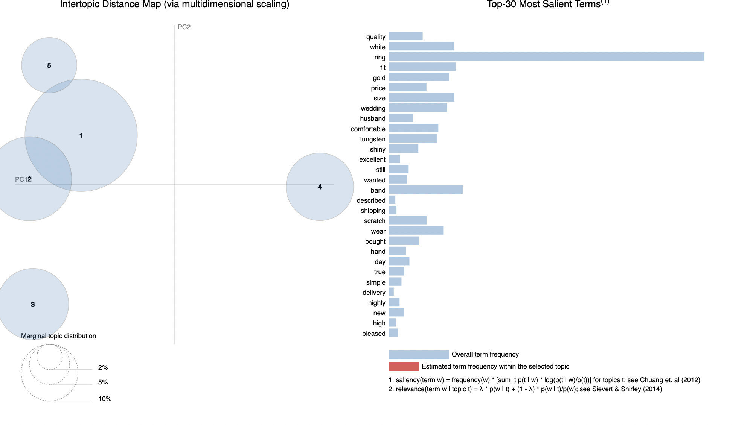
Visualize using PyLDAvis

Slide 17
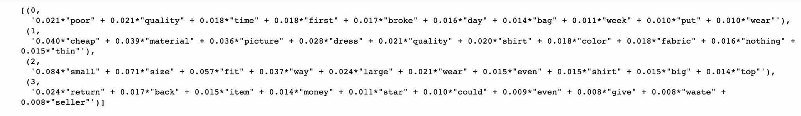

LDA - Topics for lowest rated reviews
Find topics most common among negative reviews in Fashion products
Damaged Item Received
Quality of the material
Size and fit issue
Better price available

Slide 18
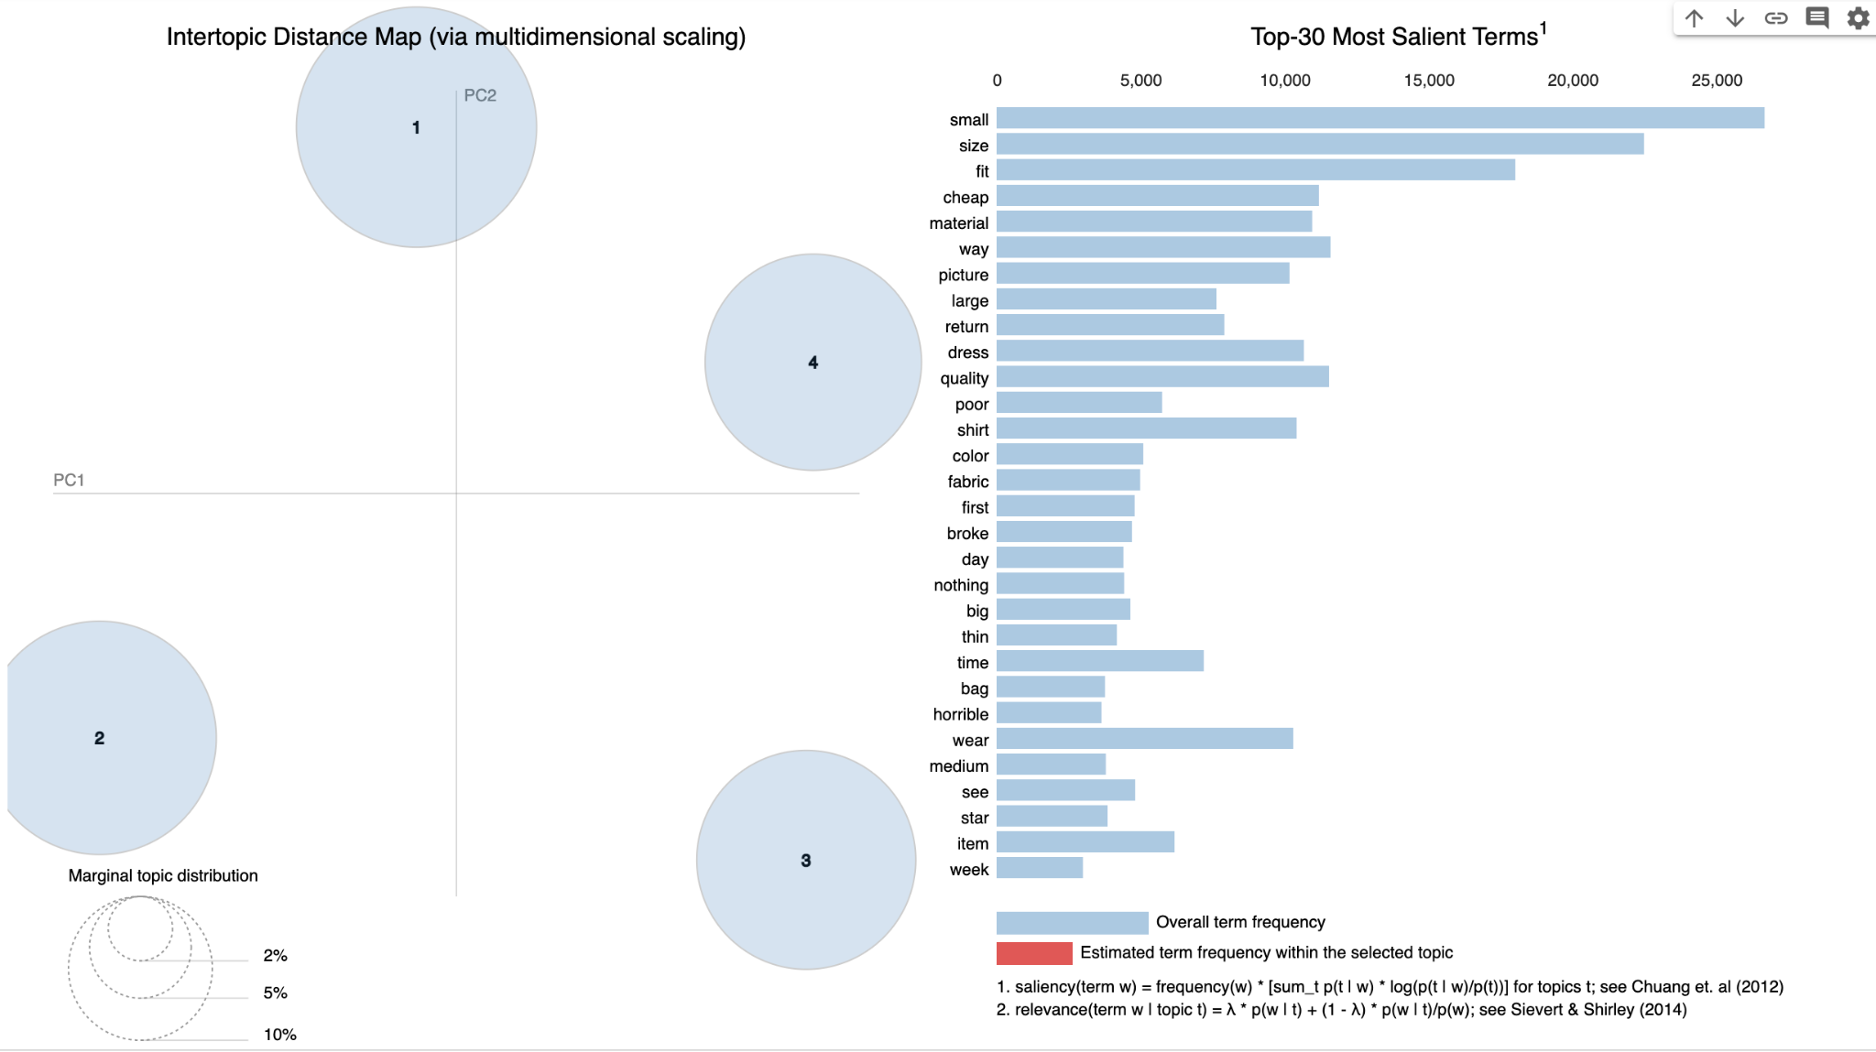
Visualize using PyLDAvis

Slide 19
LDA - Topics for lowest rated reviews
Highly reviewed item with low rating: Hanes Men's EcoSmart Fleece Sweatpant
Two most common issues:
Size Too Small
Size Too Large
Use Size Recommender tool
Accurate Sizing chart
Competitor brand sizing
Recommendations:

Slide 20
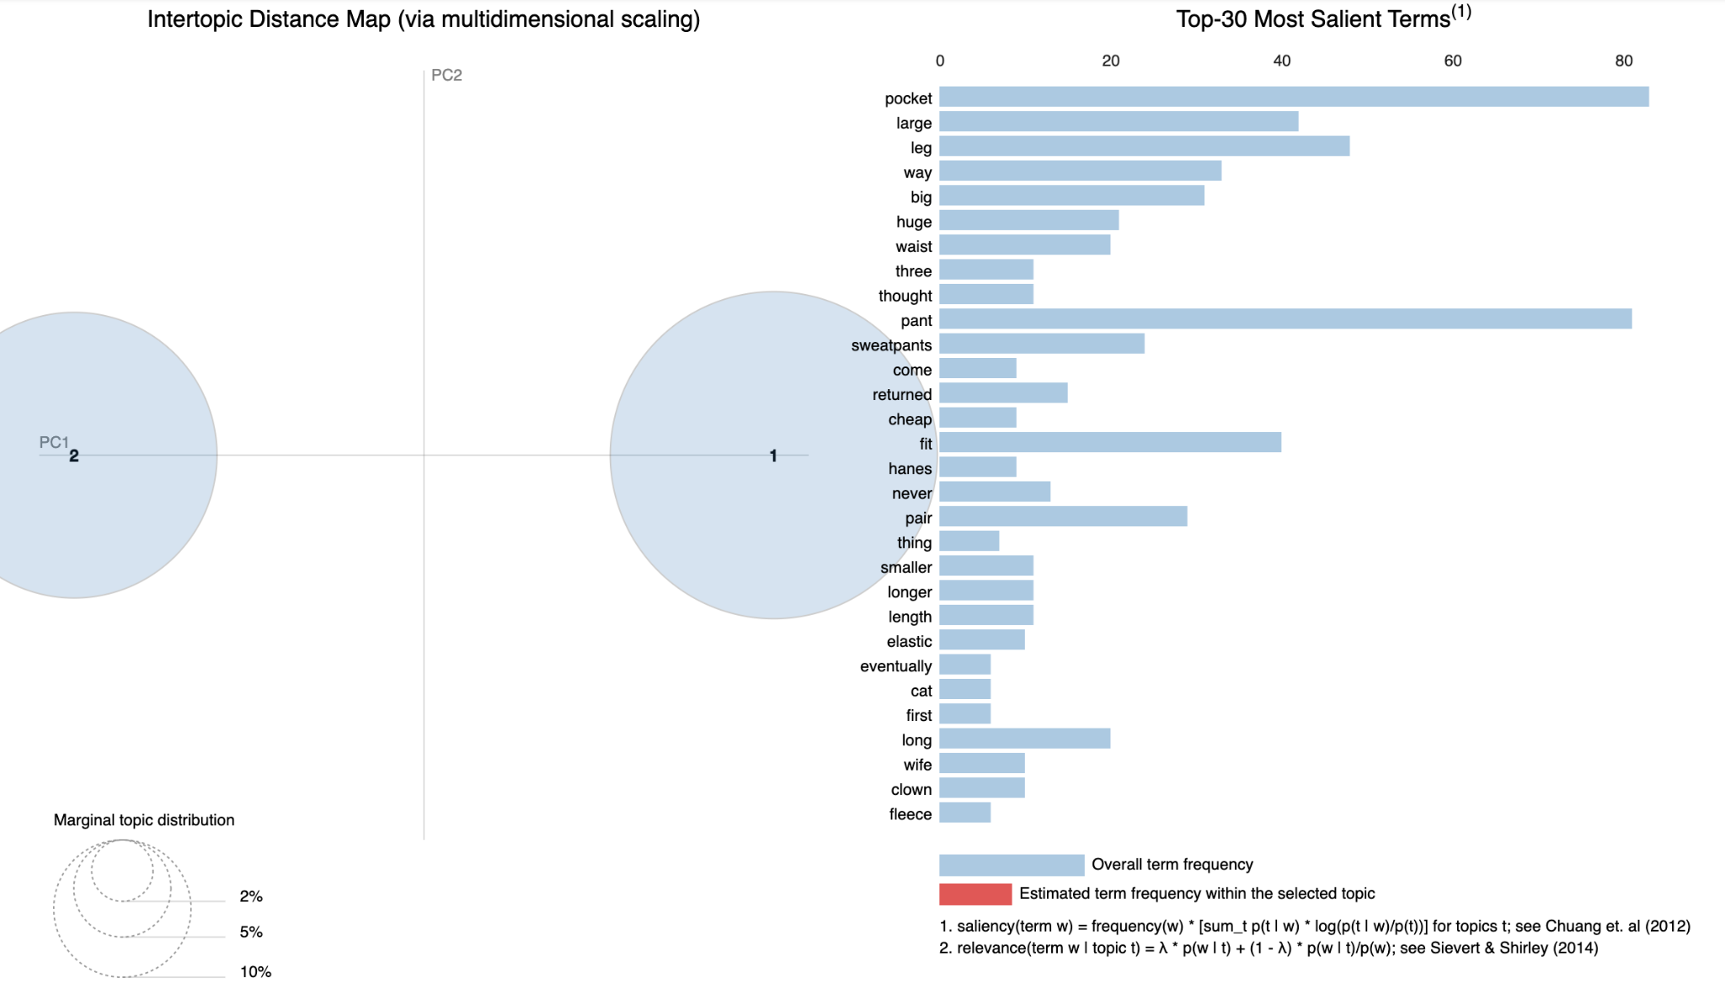
Visualize using PyLDAvis

Slide 21

What is BERTopic?
BERTopic is a topic modeling python library that combines transformer embeddings and clustering model algorithms to identify topics in NLP. It also supports visualizations similar to LDAvis!
Notes:
BERTopic is another topic modeling technique that leverages transformers and c-TF-IDF to create dense clusters allowing for easily interpretable topics whilst keeping important words in the topic descriptions. There are four key components used in BERTopic - A transformer embedding model, UMAP dimensionality reduction, HDBSCAN clustering, Cluster tagging using c-TF-IDF

Slide 22

BERTopic Model Algorithms
Document Embedding model converts documents into vector representations.
BERTopic also allow to use other pretrained models from Hugging Face, Flair, spacy, gensim,etc.
Document Embedding
BERTopic uses the English version of the sentence_transformers by default to get document embeddings.
Notes:
So, the document embedding will convert documents into vector representations and BERTopic supports several libraries for encoding the text to dense vector embedding like Hugging face, Flair, Spacy and genism and sentence transformers. We have used sentence transformers in our case as it provides the most extensive library of high-performing sentence embedding models. It’s also default in case of bert topic

Slide 23

BERTopic Model Algorithms
Dimensionality Reduction
Default algorithm for dimension reduction is UMAP (Uniform Manifold Approximation & Projection)
Default algorithm for clustering is HDBSCAN. HDBSCAN is a hierarchical, density-based method and determines the no of clusters automatically
Document Clustering
Notes:
After building our embeddings, BERTopic compresses them into a lower-dimensional space for which it uses Umap : Non-linear dimensional reduction,which preserves both local and most of the global structure.
The next step is to run a clustering model
HDBSCAN is a hierarchical, density-based method. Meaning we can benefit from the easier tuning and visualization of hierarchical data, handle irregular cluster shapes, and identify outliers.It also determines the no of clusters automatically

Slide 24

BERTopic Model Algorithms
Topic Representation
For topic representation, BERTopic uses a class-based TF-IDF called c-TF-IDF. The top words with the highest c-TF-IDF scores are selected to represent each topic.
TF-IDF, TF measures the term frequency in each document.
c-TF-IDF, TF measures the term frequency in each cluster, and each cluster includes many documents.
Notes:
The final step in BERTopic is extracting topics for each of our clusters. To do this, BERTopic uses a modified version of TF-IDF called c-TF-IDF.
TF-IDF is a popular technique for identifying the most relevant “documents” given a term or set of terms. c-TF-IDF turns this on its head by finding the most relevant terms given all of the “documents” within a cluster.

Slide 25

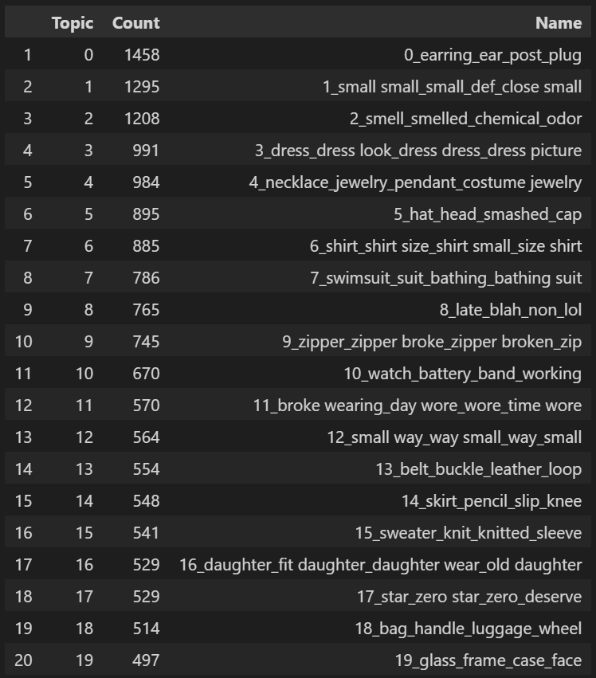
BERTopic Results
Top 20 Topics (Rating < 2)
Notes:
Similarly, We ran the bert topic modeling on 100k reviews with rating < 2(negative reviews) and the results show few of the topics which were determined and for each topic we have top 8 words based on their c- tfidf scores.

Slide 26
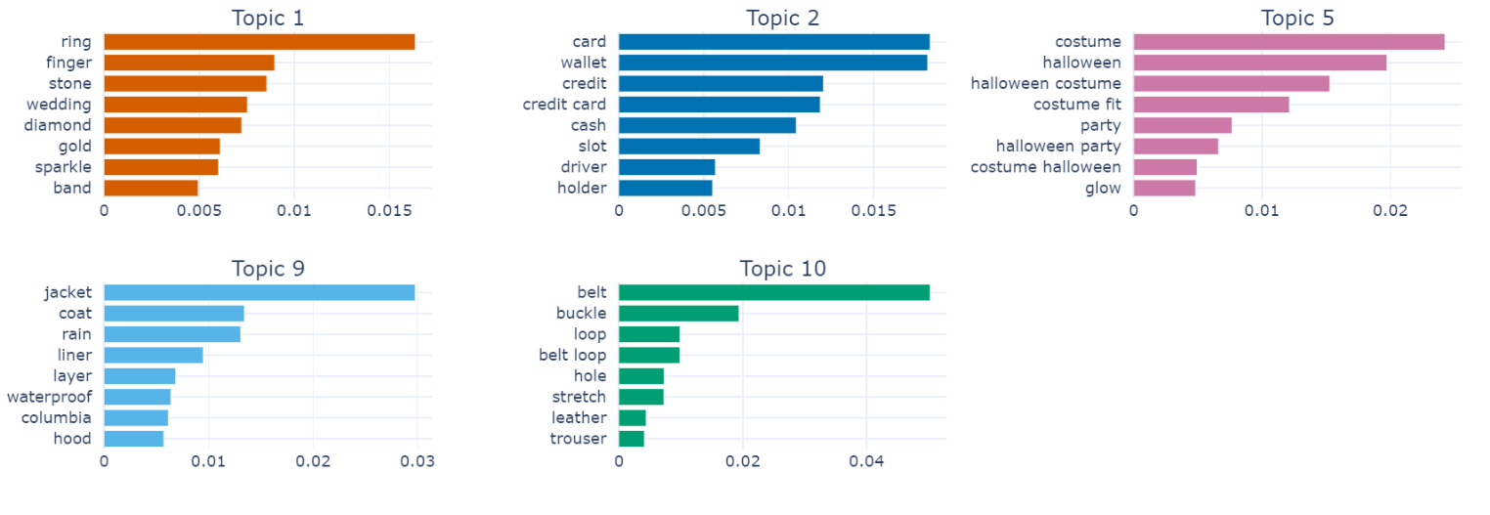
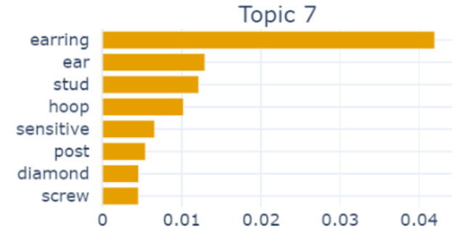
BERTopic Results
Topic Word Scores (Rating > 4)
(Wedding Ring)
(Credit card wallet)
(Halloween Costume)
(Rain Jacket/Coat)
(Belt)
(Earrings)
Notes:
We ran the bert topic modeling on 100k reviews with rating > 4(positive reviews) and the results show few of the topics which were determined and for each topic we have top 8 words based on their c- tfidf scores. The length of the bar represents the score of the keyword. A longer bar means higher importance for the topic.

Slide 27
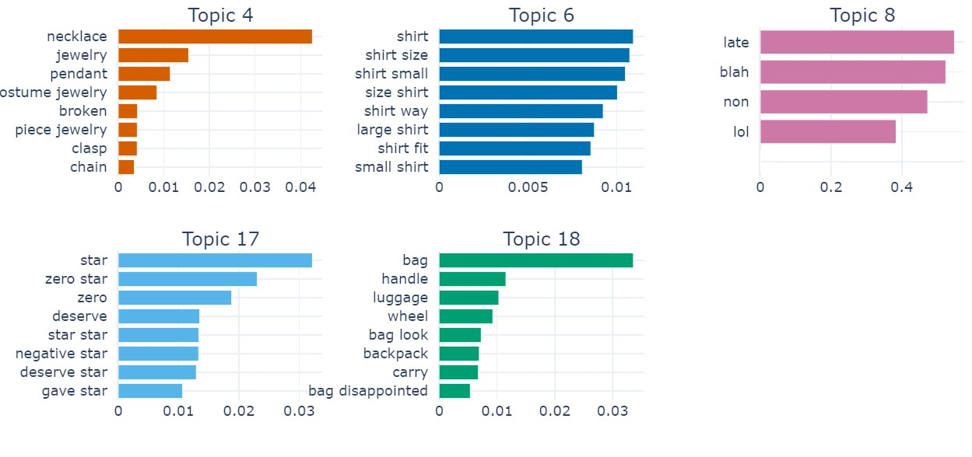
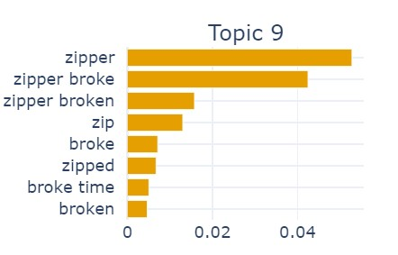
BERTopic Results
Topic Word Scores (Rating < 2)
(Jewelry)
(Shirt Size issue)
(Late Delivery)
(Bad Rating review)
(Bags)
(Damaged Zipper)
Notes:
Similarly, We ran the bert topic modeling on 100k reviews with rating < 2(negative reviews) and the results show few of the topics which were determined and for each topic we have top 8 words based on their c- tfidf scores.

Slide 28
References:
https://www.analyticssteps.com/blogs/what-topic-modelling-nlp
https://www.analyticsvidhya.com/blog/2016/08/beginners-guide-to-topic-modeling-in-python/
Presentation :https://www.freepik.com/
https://medium.com/analytics-vidhya/latent-dirichelt-allocation-1ec8729589d4
https://medium.com/grabngoinfo/topic-modeling-with-deep-learning-using-python-bertopic-cf91f5676504
https://maartengr.github.io/BERTopic/index.html
https://towardsdatascience.com/topic-modeling-with-nlp-on-amazon-reviews-an-application-of-latent-dirichlet-allocation-lda-ae42a4c8b369
https://www.pinecone.io/learn/bertopic/

